Slide 1
Project 2

Slide 2
Online setting
Recitations
Monologue for approx. 15 minutes.
Everyone is muted, please raise hand in the participant section of the meeting.
Video would help but it is not necessary.
Piazza
Office Hours
10 minutes slot per meeting.
30 minutes cap per student per week.
Can book it with any TA/CA/Instructor.

Slide 3
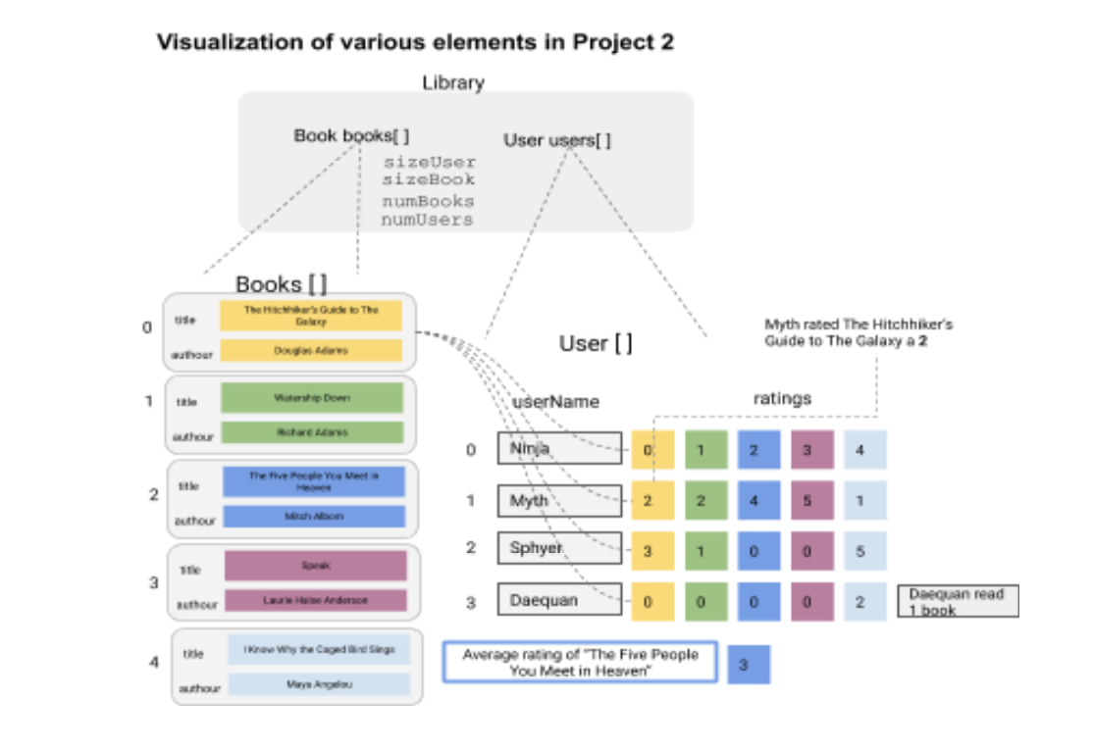

Slide 4
Attendance Password: project2lib

Slide 5
Break out rooms
Multiple discussion rooms – randomly assigned.
DO NOT SHARE SCREEN – while we trust y’all, someone could pick up the code shared and this will raise a flag for honor code.
For all such code-based issues please book a OH slot with TA/CA/Instructor.
I will be rotating around rooms to address any common questions.

